Slide 1
Introduction to Software Engineering
Lab 03: Essential Development Tools

Slide 2
Introduction
Introduction to project management platforms
Use of browser-based tools like Chrome DevTool
Processes for creating, testing, and documenting RESTful APIs
Brief introduction to functional documentation and its role in development

Slide 3
Objectives
Understand the role of project management tools like trello in software development.
Explore the features of Chrome DevTools for debugging and optimizing web applications.
Develop, test, and document RESTful APIs.
Gain insights into effective coding styles and practices for clean, maintainable code.

Slide 4
ؤ
Definition: Essential for organizing tasks, tracking progress, and enhancing team communication.
Examples: Trello, JIRA
Key Benefits:
Streamlines workflows.
Assign tasks, set deadlines, monitor project status.

Slide 5

Trello
Overview: Trello is a visual project management tool that organizes tasks into boards, lists, and cards for better workflow management.
Practical Use:
Organizing Tasks
Assigning Tasks
Collaboration

Slide 6
Trello Cont.
Example: Set up a Trello board to track the development stages of Building a RESTful API for a Todo List Web Application.

Slide 7
Chrome Developer Tools
Overview: Crucial for web development, offering real-time inspection and debugging.
Key Features:
Inspect elements and view network requests.
Analyze performance metrics.
Benefit: Quickly identify and resolve web application issues.

Slide 8
Browser-Based Debugging Tools
Real-time Code Inspection and Debugging
In-Depth Network Traffic Analysis
Comprehensive Performance Audits with Lighthouse:

Slide 9
Functional Documentation
Describes a software system's features from a user’s perspective, detailing what the system should do without specifying how it should be implemented.
Includes Requirements, use cases, inputs, outputs, and interactions.
Serves as a guide for developers and stakeholders to ensure the system aligns with intended objectives.

Slide 10
Functional Requirements Example
User Story: As a customer, I want to be able to book a product from an online store so that I can ensure it is reserved for me and pick it up or have it delivered at a later time.
Functional Requirements:
FR1: Product Booking
FR2: Confirmation of Booking

Slide 11
What is RESTful API
Definition: An interface for web-based communication between applications using REST (Representational State Transfer).
Key Characteristics:
Uses HTTP for data transfer.
Works seamlessly with web architecture.
Scalable and stateless.

Slide 12
How RESTful API works
Client-Server Architecture:
Client: Initiates a request
Server: Processes request, sends back a
Stateless Communication:
Each client request is independent
Middleware Role:
Intermediary that processes requests.
Handles authentication, logging, error handling, and data transformation.

Slide 13
Components of RESTful API
API Client
API Request
API Server
API Response

Slide 14
API Client
An API Client is a software application or tool that interacts with a RESTful API by sending HTTP requests and receiving responses.
Key Functions:
Send Requests
Receive Responses
Examples:
Web / Mobile APP
Postman

Slide 15
API Request
Definition: An API Request is a message sent from the API client to the API server, asking for a specific action or data.
Components:
Endpoint: /todos
HTTP Methods: GET, POST, PUT, DELETE
Headers: content types
Body: Contains data for actions like POST
Example: GET /todos - Fetch all todo items

Slide 16
API Server
Definition: The backend system that receives API requests, processes them, and returns responses.
Role: Acts as the gateway between clients and the database or other backend services.
Key Functions:
Routing
Processing
Examples: Backend frameworks like Express.js

Slide 17
API Response
Definition: An API Response is the data sent back from the API server to the client after processing a request.
Components:
Status Code
Headers
Body
Example: Fetching all your tasks in a todo app

Slide 18
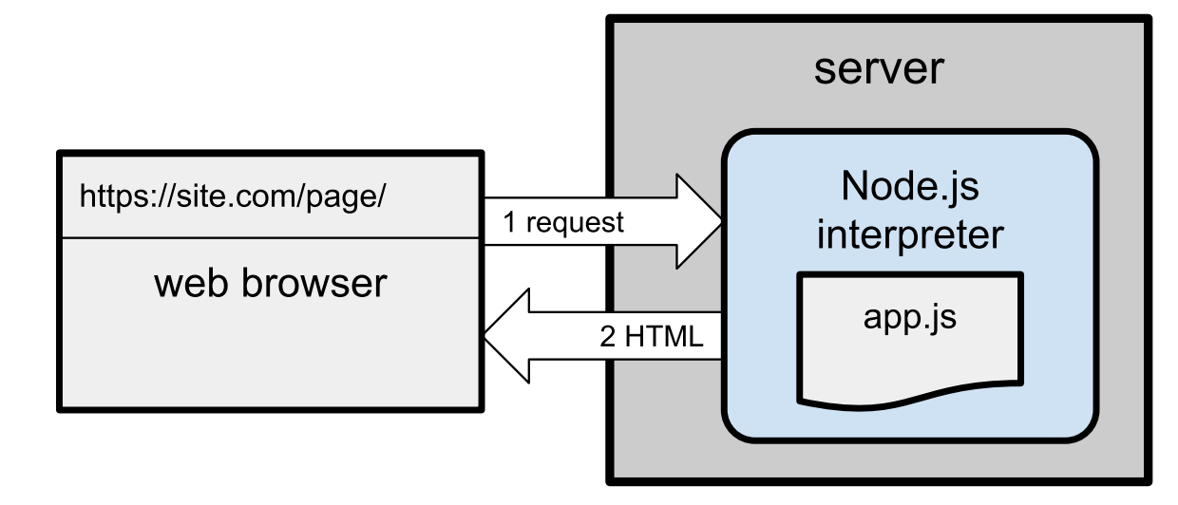
Client-server architecture

Slide 19

Postman for API Testing
Postman simplifies the process of testing APIs by allowing developers to send requests and validate responses seamlessly.
Ensures APIs meet both functional and performance requirements.

Slide 20

Swagger for APIs Documentation
Swagger Editor: A browser-based editor for creating and editing API specifications in YAML or JSON format.

Slide 21
Coding Style
Coding style refers to a set of guidelines for writing and formatting code, enhancing readability and maintainability. Key aspects include:
Code Structure
Error Handling
Commenting

Slide 22
Creating Simple RESTful API for Todo list App Using Flask
Build a basic RESTful API using Flask, focusing on CRUD operations for managing a to-do list.
Then Test That API using Postman
Look at old and updated code to notice the effect of applying best practices and coding style.
Use Swagger Editor to create Documentation.

Slide 23
Todo List API
Step 1: Create a Basic Server
Step 2: Initialize In-Memory Data and set up a middleware function to verify tokens
Step 3: GET Endpoint
Step 4: POST Endpoint
Step 5: PUT Endpoint
Step 6: DELETE Endpoint
Step 7: Middleware for 404 Errors

Slide 24
Testing the API Using Postman
In this section, I will test the four primary operations of our RESTful API
Fetch all todo items (GET)
Create new todo items (POST)
Update a todo item (PUT)
Delete a todo item (DELETE)

Slide 25
Operation 1 - GET /todos
Purpose: Fetch all todo items (initially an empty list).
Request:
Method: GET
URL: http://localhost:<port>/todos
Expected Response:
Status: 200 OK
Body: [] (Empty list)

Slide 26
Operation 2 - POST /todos
Purpose: Create new todo items.
Request:
Method: POST
URL: http://localhost:<port>/todos
Headers:
Content-Type: application/json
Body (JSON):
The Actual JSON Data

Slide 27
Operation 2 - POST /todos (Cont.)
Expected Response:
Status: 201 Created for each.
Body: JSON with the newly created todo item details.

Slide 28
Operation 3 - PUT /todos/id
Purpose: Update the 3rd todo item.
Request:
Method: PUT
URL: http://localhost:<port>/todos/id
Headers:
Content-Type: application/json
Body (JSON):
Your Updates in JSON Format

Slide 29
Operation 3 - PUT /todos/id (Cont.)
Expected Response:
Status: 200 OK
Body: Updated todo item details.

Slide 30
Operation 4 - DELETE /todos/id
Request:
Method: DELETE
URL: http://localhost:<port>/todos/id
Headers:
Content-Type: application/json
Authorization: <your-token-here>
Expected Response:
Status: 200 OK
Body: JSON message confirming deletion.

Slide 31
Requirements
Create a Simple API with at least 5 endpoints with simple authentication
Develop a Postman collection that tests the API
Document Your API using Swagger

Slide 32
Thank You

